Slide 1
The FireSmart Plant & Landscaping Program

Slide 2
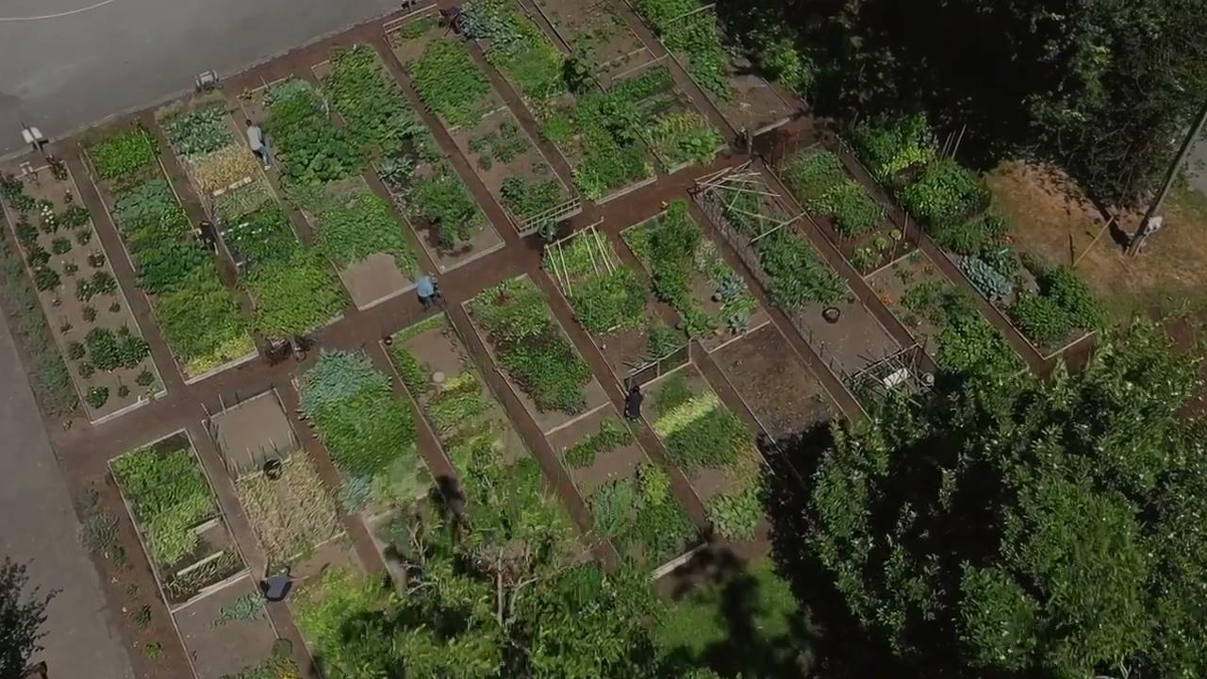

Slide 3
About the Program

Slide 4
FireSmart Plant Program
What is FireSmart BC?
FireSmart BC is a provincial program, based on the FireSmart Canada
model, committed to educating British Columbians on the risks of wildfires.
The program empowers homeowners and communities to mitigate the
impacts of fire through tried and tested solutions. FireSmart BC is overseen
by the BC FireSmart Committee, an organization that consists of key
wildfire management agencies and partners from across the province.

Slide 5
FireSmart Plant Program
What is the FireSmart BC Landscaping Guide?
The FireSmart BC Landscaping Guide is a must-have resource designed to help
British Columbians make their properties more resilient to wildfire. This handy guide
provides homeowners and renters with clear information and proven practices for
managing their lawns, plants, and gardens in the most FireSmart way possible. The
guide outlines a comprehensive list of species, property layout options, and plant
maintenance practices that reduce risk to communities from a variety of natural
hazards. It additionally provides recommendations on choosing plants that will help
conserve water, attract pollinators and that are native to our local ecosystem.

Slide 7
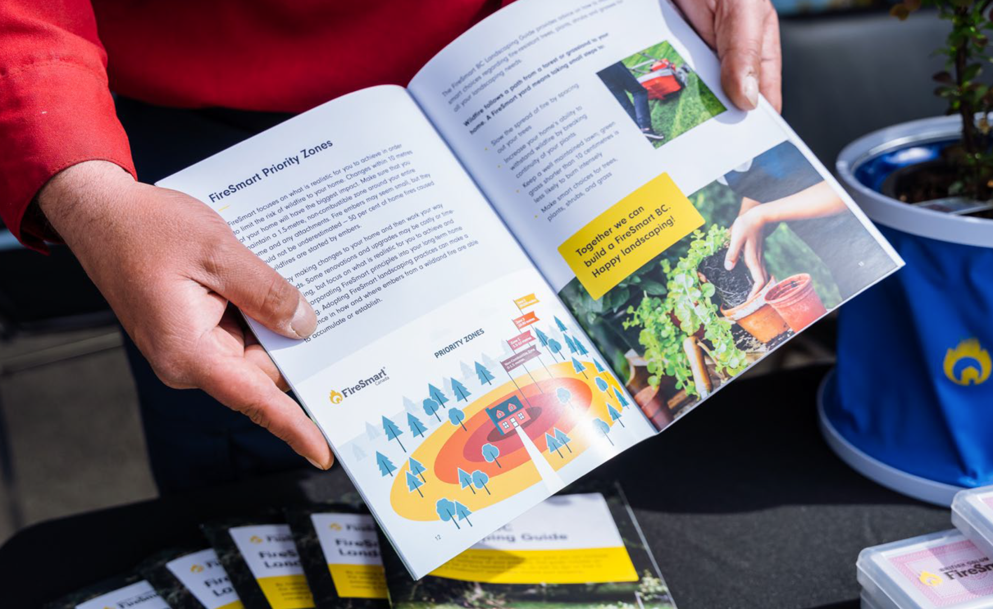
FireSmart Plant Program

Slide 8
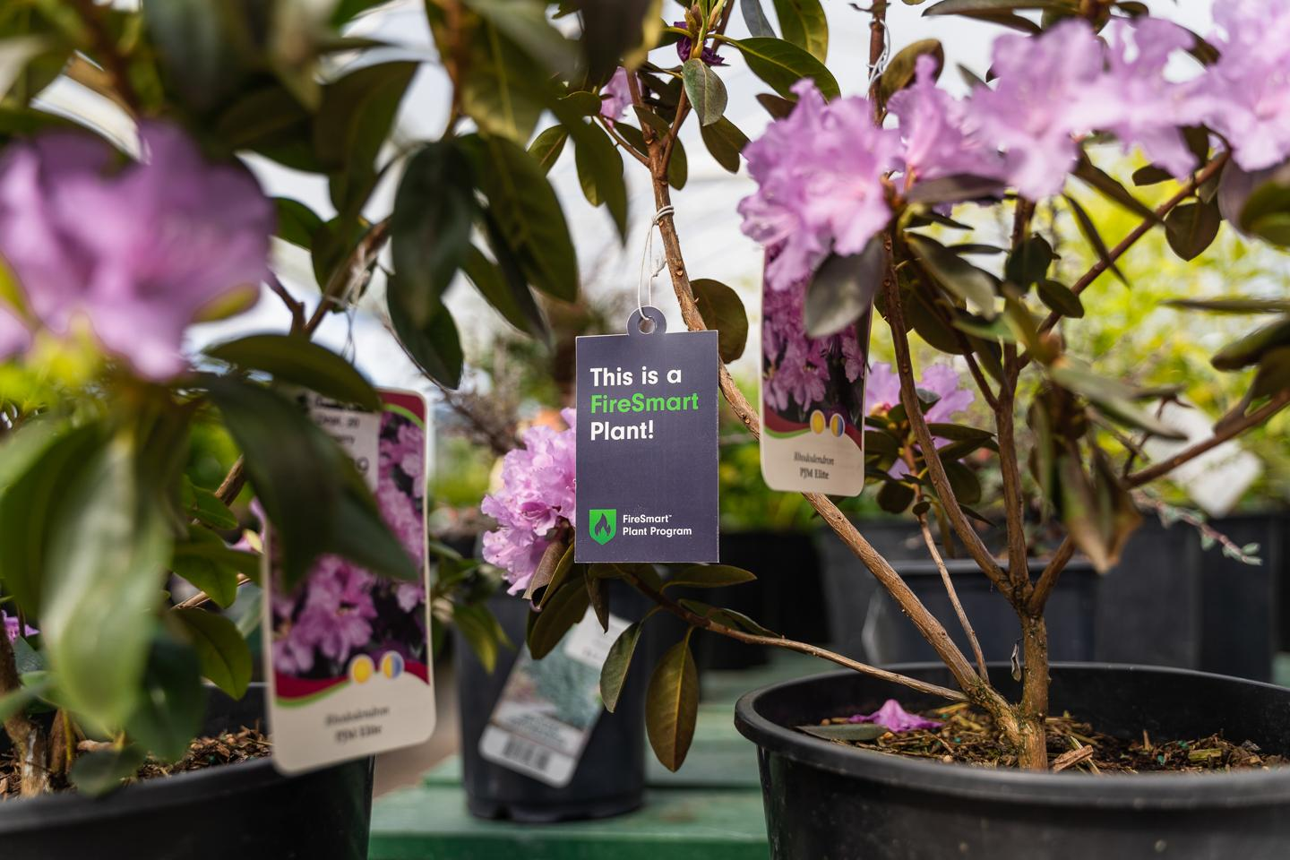
FireSmart Plant Program
What is the Plant Program?
A simple, visual way to showcase which plants are considered more fire-resistant at the point of purchase!

Slide 9
FireSmart Plant Program
What is the Plant Program?
Launched as a pilot program in the Spring of 2021 at two Art Knapp garden centres in Kamloops and Prince George. Feedback from both garden centres and the public was overwhelmingly positive, resulting in a province wide roll out in 2022 with over 30 participating stores!

Slide 10
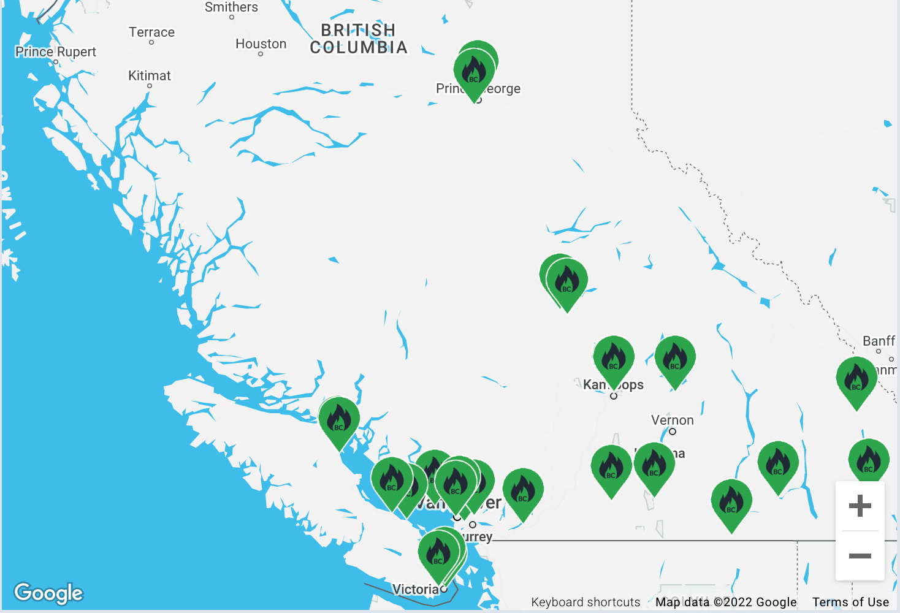
FireSmart Plant Program
Participating Stores
We have locations across the province participating in the program.
For a list of all participating locations visit https://firesmartbc.ca/landscaping-hub/plant-program/

Slide 11
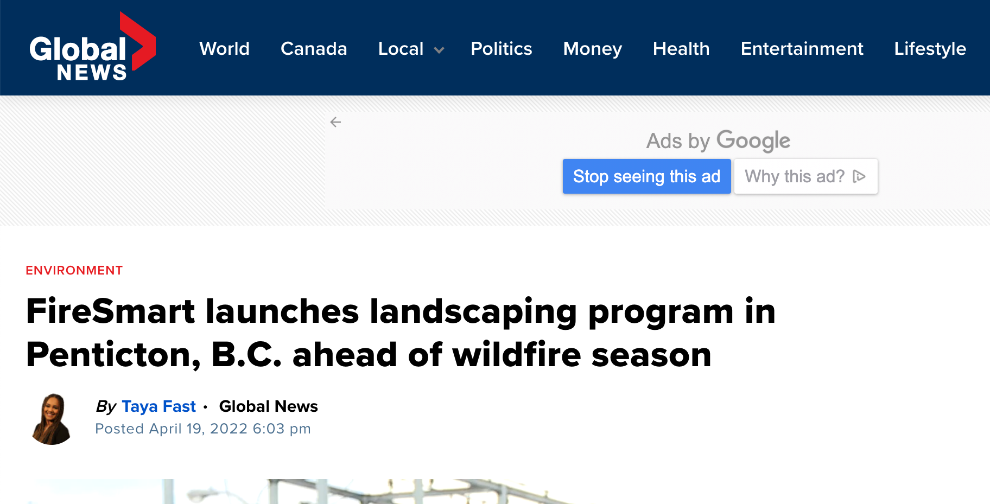
FireSmart Plant Program
News Stories
The launch of the program in April of 2022 had a wide reach with stories across a variety of news outlets - including CTV, Global, and CBC!

Slide 12
Landscaping Hub

Slide 13
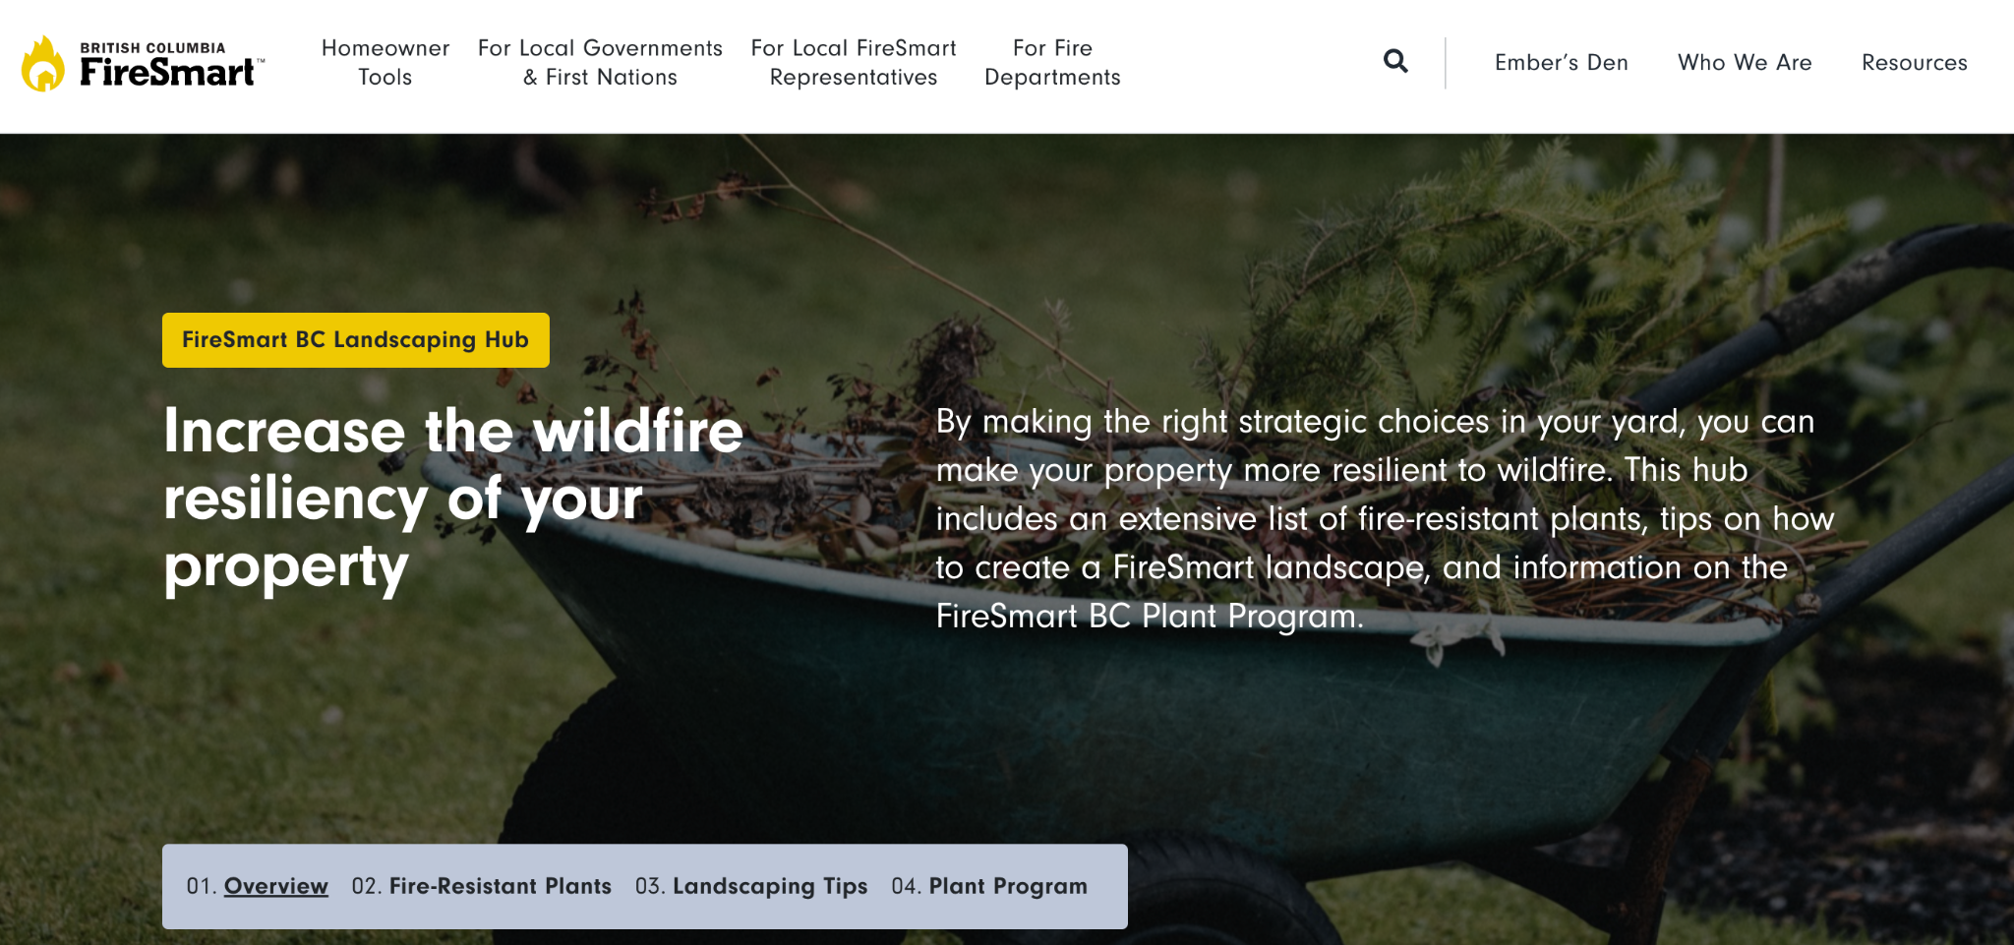
FireSmart Plant Program
What is the hub?
This hub includes:
Interactive Fire-Resistant Plants tool based on your region
Tips on how to create a FireSmart landscape
Information on the FireSmart BC Plant Program.
https://firesmartbc.ca/landscaping-hub/

Slide 14
Become Involved

Slide 15
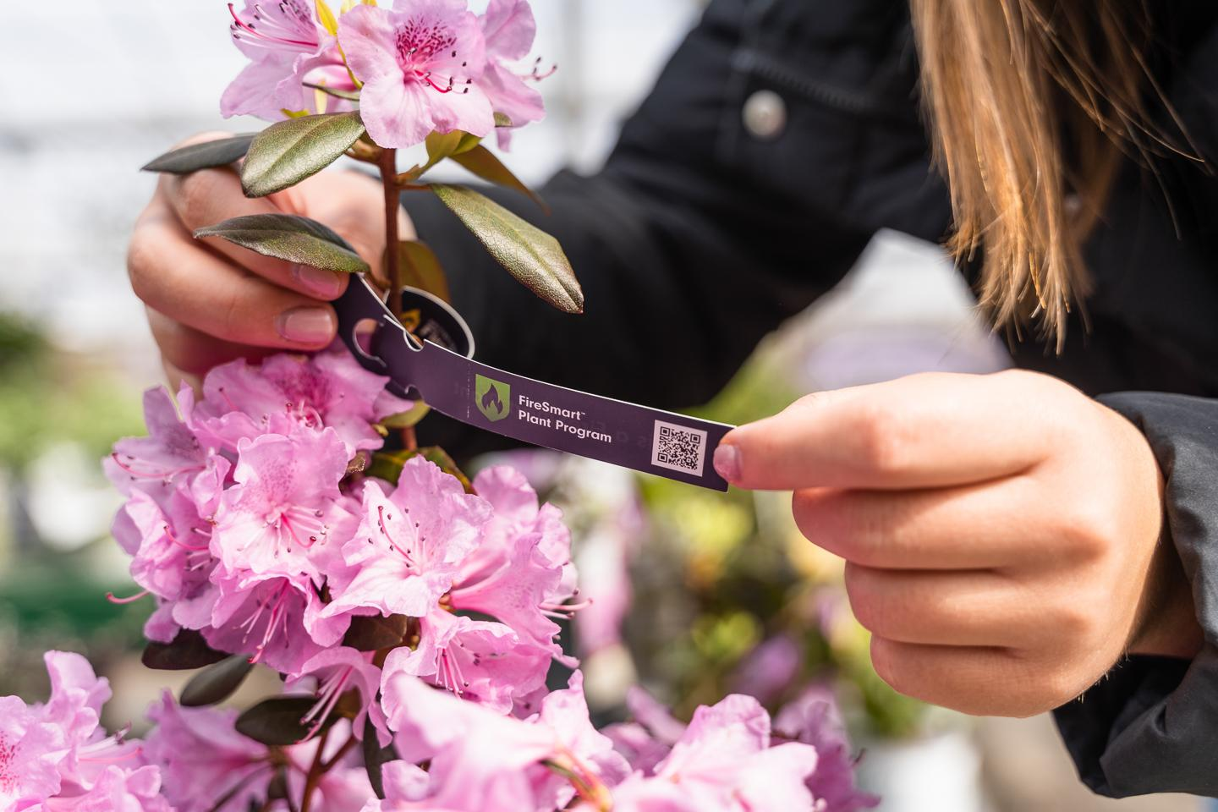
FireSmart Plant Program
How to participate in the program:
Visit the Landscaping Hub on the FireSmart BC website.
Visit your local participating garden centre and purchase Fire-Resistant plants
Read the landscaping guide (virtual or pdf)
Spread the word to family, friends, and neighbours
Stay up to date with the program through Social Media
Attend a local event

Slide 16
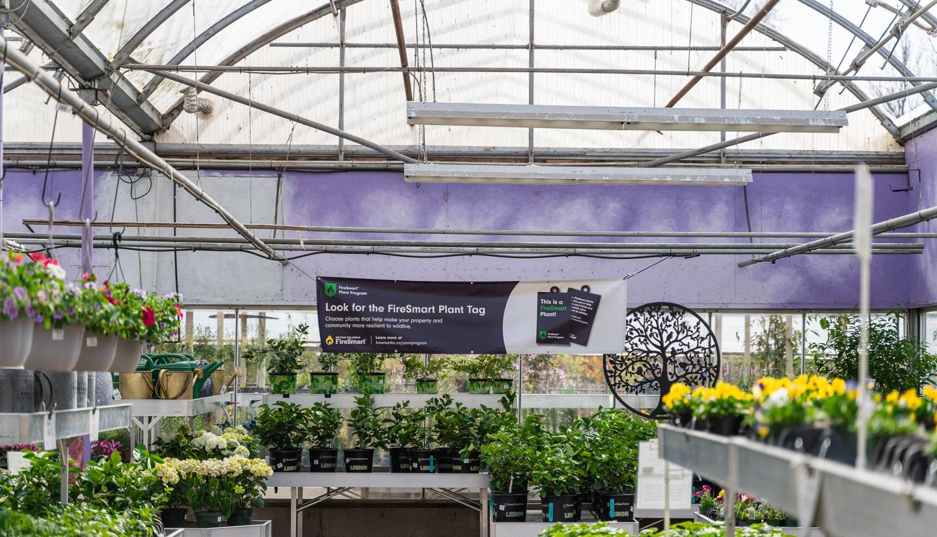
FireSmart Plant Program
To Learn More Visit: firesmartbc.ca/landscaping-hub
Or send an email to landscaping@FireSmartBC.ca

