Slide 1

Notes:
Notes for presenter:
Please do not change the messaging in this presentation except to add the community name, location, date or other pertinent event details you may have to Slide 2 as well as your contact information at the end of the presentation.
You may remove slides that are not relevant to your audience or add slides that cover topics specific to your presentation that do not address general FireSmart messaging.
If there is a topic that you would like to see added please contact info@firesmartbc.ca

Slide 2
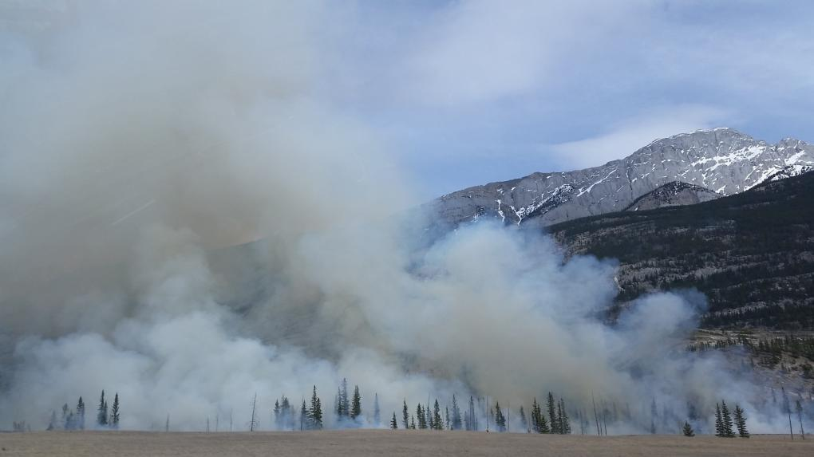
It’s time to get FireSmart® about wildfires in B.C.
Community Name, Location, Date
Notes:
It’s time to get FireSmart about wildfires in BC
Your community might not be ready to face this year’s wildfires. This presentation will help you be prepared.
Insert the details relevant to your presentation “community name, location, date” for example
VIDEO: To play the FireSmart Video: https://firesmartbc.ca/resource/why-firesmart/

Slide 3

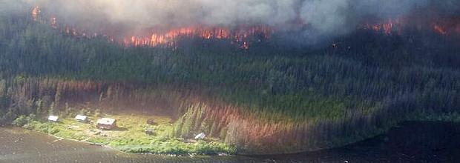
Agenda
Review of recent wildfire seasons
Wildfires in B.C.
Role of FireSmart
FireSmart Community Recognition program
FireSmart BC

Slide 4
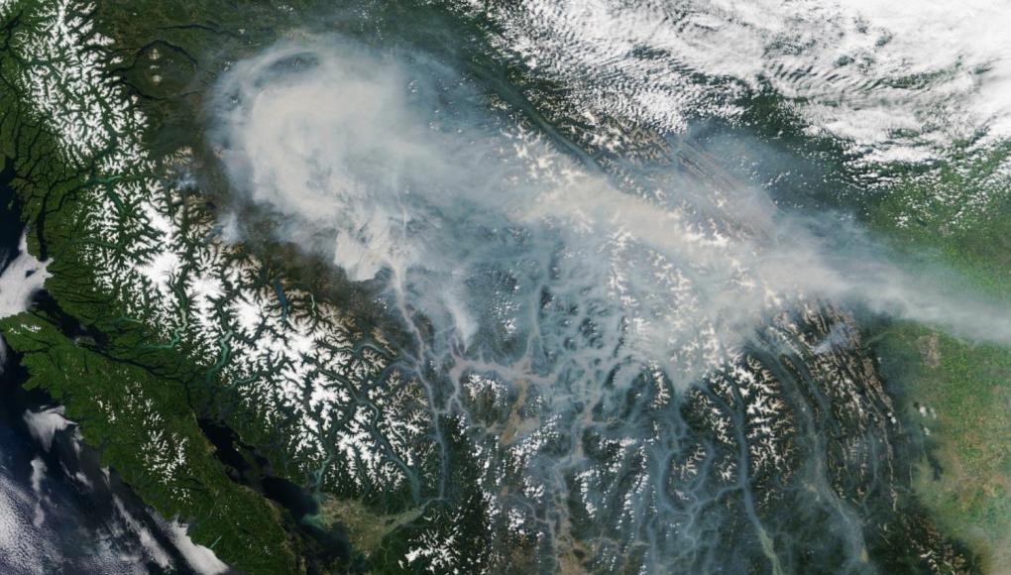
Review of recent wildfire seasons

Slide 5
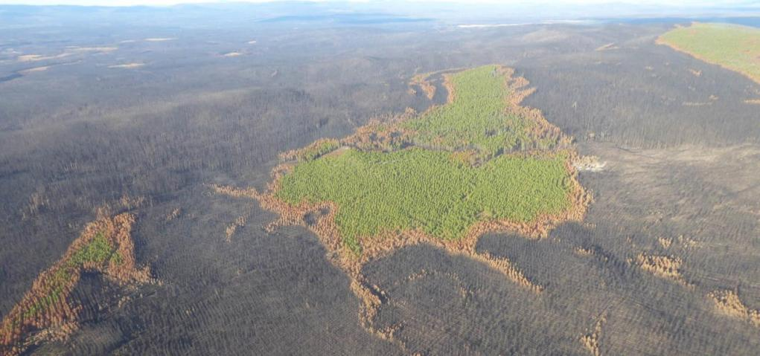
1.22 million hectares of land burned by 1,347 wildfires in 2017
1.34 million hectares of land burned by 2,068 wildfires in 2018

Slide 6
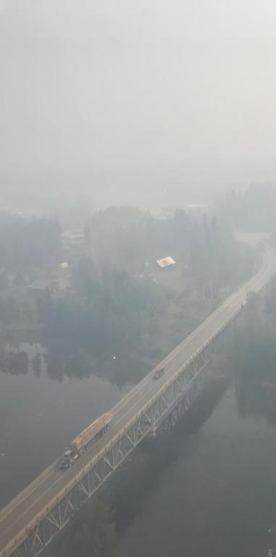
Human impact
(statistics courtesy of Emergency Management BC)
 | 2017 | 2018
EVACUATION ORDERS | 120 | 66
EVACUATION ALERTS | 166 | 124
PROPERTIES ON ORDER | 18,737 | 2,211
PROPERTIES ON ALERT | 10,656 | 17,939
EMERGENCY SOCIAL SERVICE RECIPIENTS | NOT AVAILABLE | 5,482
TOTAL DAYS ON PROVINCIAL STATE OF EMERGENCY | 71 (July 7 to Sept 15) | 24 (Aug 15 to Sept 7)
Notes:
This table compares the human impact of 2017 and 2018 fire seasons, by measure of how many evacuation alerts and orders were implemented, how many properties were impacted, how many emergency social service recipients there were, and how long the provincial state of emergency lasted.

Slide 7
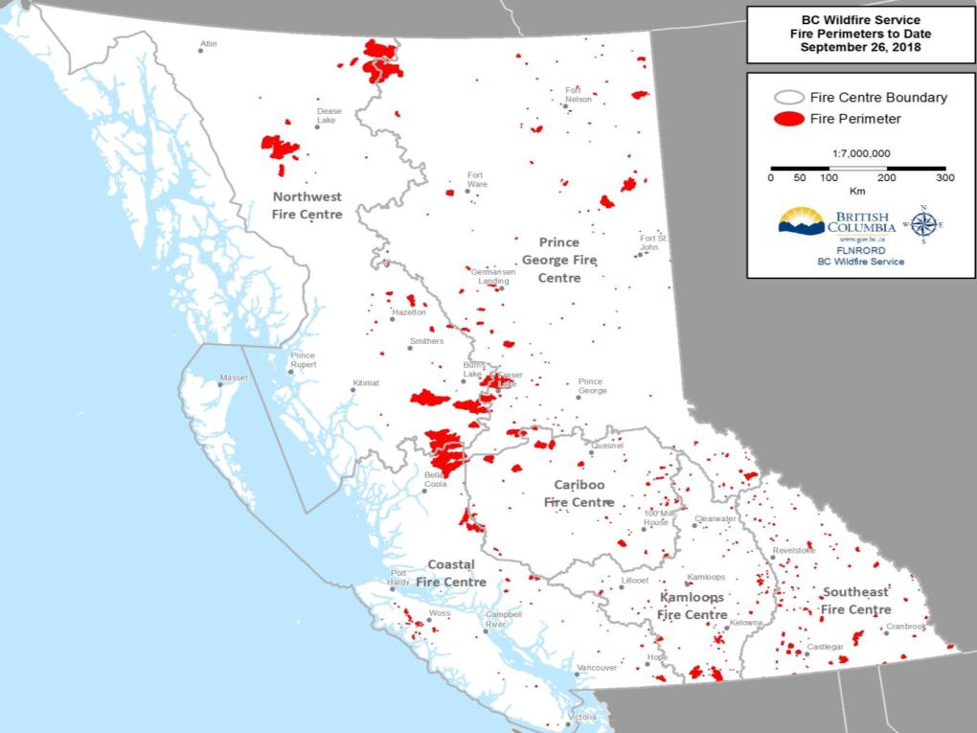
Notes:
This map spatially displays the fire perimeters of the wildfires that burned during 2018.
While the largest wildfires occurred in the Northwest Fire Centre, one unique characteristic of the 2018 wildfire season was how widespread the fire activity was across all six fire centres. All six of the fire centres experienced a number of their own “Wildfires of Note” – that is, wildfires that were highly visible and, in some cases, posed a potential threat to public safety.

Slide 8
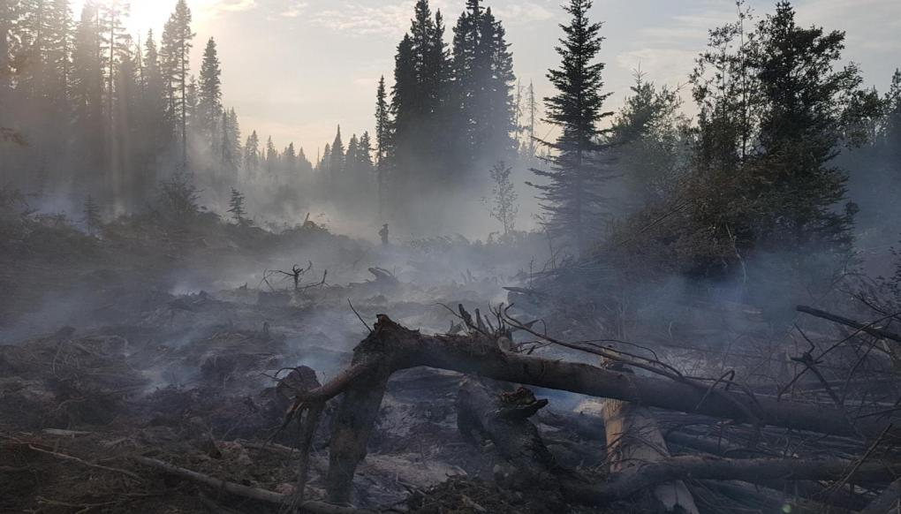
Wildfires in B.C.

Slide 9
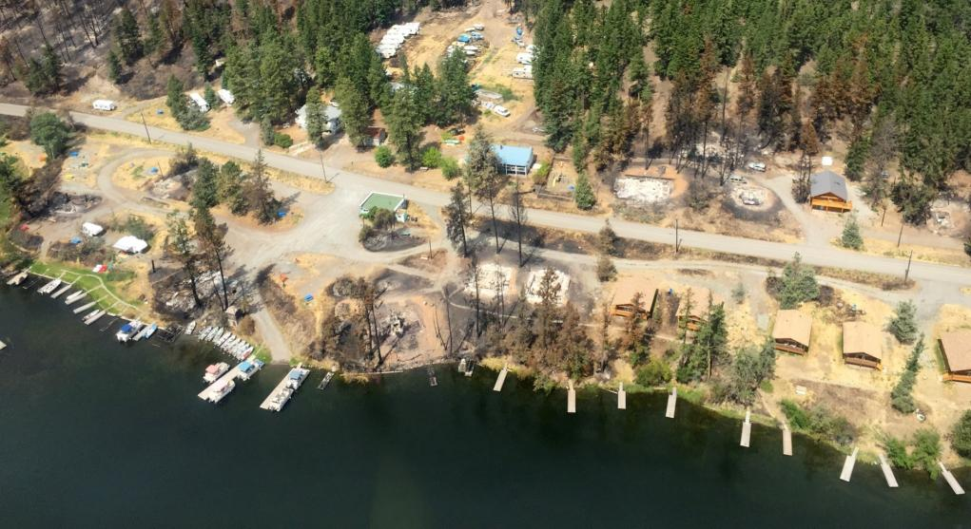
B.C. is experiencing a serious and sustained increase in extreme wildfire behaviour in the
Wildland Urban Interface (WUI).

Slide 10
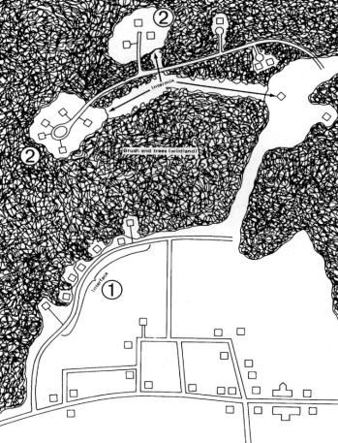
Wildland Urban Interface
What is the WUI?
WUI refers to the “wildland urban interface”.
It is the zone of transition between wildland forest and human development.
The lands and communities next to and surrounded by wildlands are at risk of wildfires.
Wildland Urban Interface

Slide 11
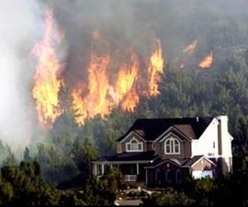
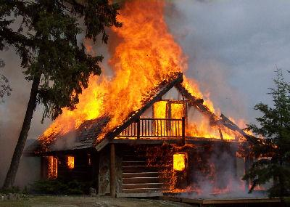
What is a WUI fire?
Where the fuel being consumed by a wildfire…
…changes from wildland fuel to urban fuel.
Structural ignition occurs when wildfire embers or flames kindle vulnerable parts of a structure.
Notes:
SO, WHAT is a Wildland Urban Interface (WUI) fire?
A WUI fire is where the fuel being consumed by a wildfire changes from wildland to urban fuel.
It does not matter to a fire, it’s all fuel! But it does matter to us!
A WUI fire occurs when wildland fire embers or flames contact the ignitable parts of a structure.
Note that the trees surrounding this home are not burning, but the home is. How could that be – in the midst of an intense forest fire?

Slide 12
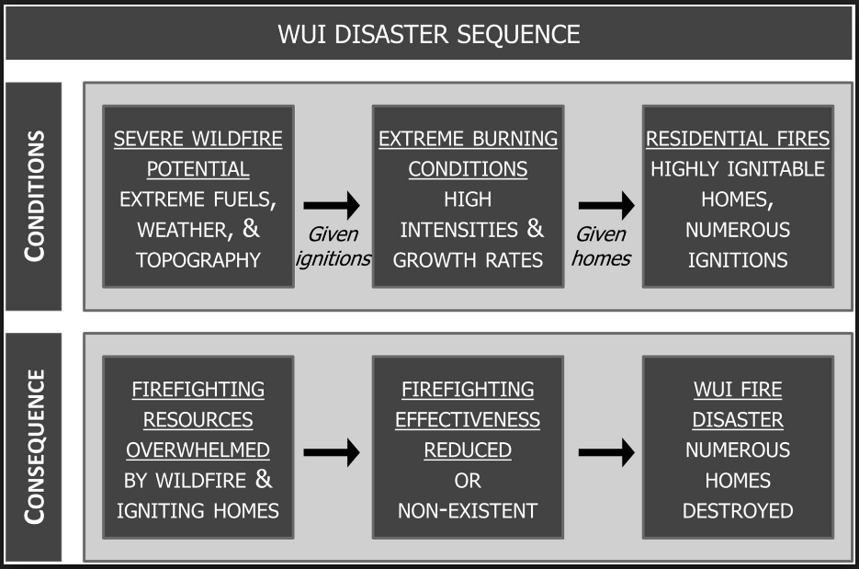
WUI Disaster Sequence
Notes:
This is the WUI disaster sequence. The pattern of how wildfires turn into urban disasters is well known and documented. This diagram shows how a catastrophic wildfire disaster occurs in which numerous homes are lost.
In order to break the cycle and prevent future disasters we need to address the point where the wildfire event makes the transition from forest fuel to structural fuels in the WUI, that is by preventing the ignition of homes, and this is where FireSmart comes into play.
“If a home does not ignite, it cannot burn… If homes don’t burn, then there is no disaster” – Jack Cohen

Slide 13
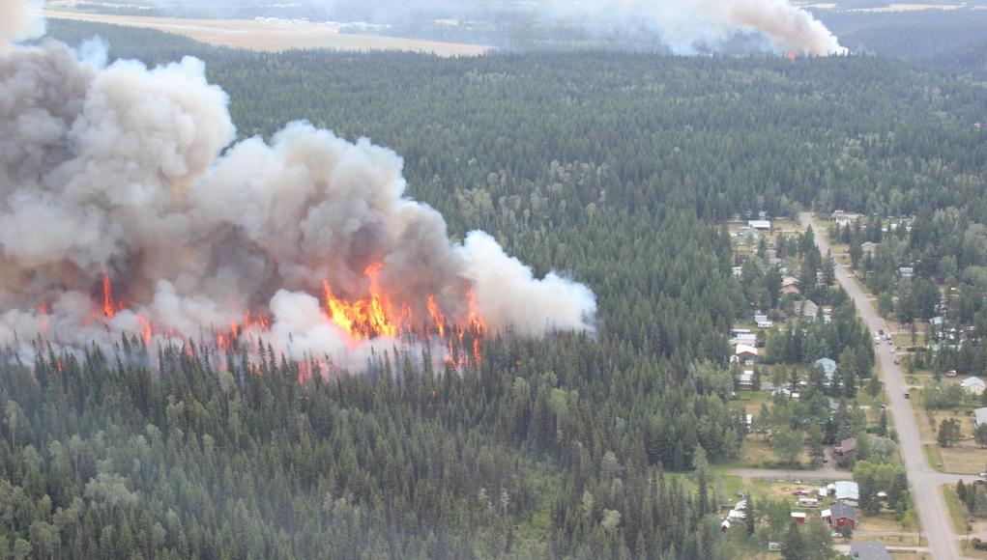
The role of FireSmart
Notes:
FireSmart is a brand owned by FireSmart Canada that includes a comprehensive set of tools and guidance on how to undertake and implement community-based wildfire prevention and mitigation initiatives.
FireSmart is based on the premise of shared responsibility and promoting integration and collaboration on wildfire prevention and mitigation. It is founded on seven disciplines that are under the responsibility or mandate of different organizations and/or levels of government.
Leadership and cooperation between the responsible agencies is necessary to fully realize the benefits of implementing FireSmart principles.
VIDEO: To play the FireSmart Video: https://firesmartbc.ca/resource/why-firesmart/

Slide 14
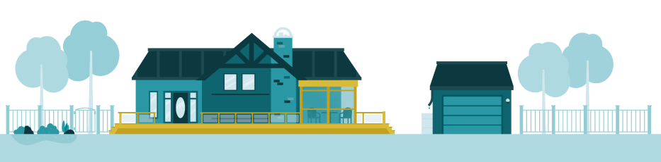
FireSmart is about living with wildfire and
managing for it on our landscapes
FireSmart is the Canadian standard recognized by all provinces and territories.
It’s based on National Fire Protection Association (NFPA) standards and has evolved over 40 years.
It’s backed by a vast amount of field, laboratory and modelling research.
FireSmart guidelines have proven their legitimacy as measures of hazard.
FireSmart methods have been demonstrated time and time again to reduce the risk of losses, under even the most extreme fire conditions.
Notes:
The science behind the FireSmart principles is indisputable.

Slide 15

The seven disciplines
Education
Vegetation management
Emergency planning
Cross-training
Interagency cooperation
Development considerations
Legislation and planning
Notes:
FireSmart utilizes seven disciplines. In order to ensure that communities are as prepared as possible for the eventuality of wildfire, they need to consider each of the seven disciplines.
The definition of the FireSmart disciplines are:
Education: Raising awareness of wildfire risks while teaching about prevention and mitigation.
Vegetation management: Managing fuels on the landscape through effective treatments using the best available science.
Emergency Planning: Participating and encouraging emergency planning by combining local knowledge with expertise in wildfire management.
Cross-training: Participating and promoting cross-training opportunities that support the delivery of the FireSmart program. For example, training with fire departments to improve fighting fires in the Wildland Urban Interface.
Interagency Cooperation: Promoting collaboration between government departments and the different levels of government to better support wildfire preparedness, prevention, response, and recovery.
Development considerations: Using best available science and technology to promote effective local government and land use planning that supports community wildfire resiliency and infrastructure survivability.
Legislation and planning: Development of policy and legislation related to: forestry management practices; integrated land use planning; compliance and enforcement programs; and legal orders.
Can show the Disciplines Overview video here – https://firesmartbc.ca/resource/firesmart-disciplines-overview/

Slide 16
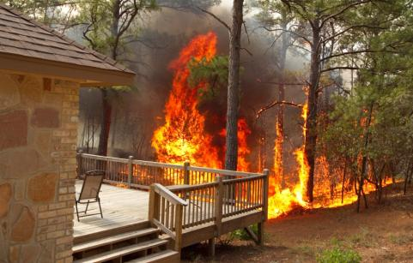
Why should I care?
During the fire season, British Columbians may be evacuated from their communities and homes may be destroyed.
Living in a forested area means that you and your community eventually will have to contend with the threat of a wildfire.
Your best protection is PREVENTION
and your best tool is the
FireSmart program.

Slide 17
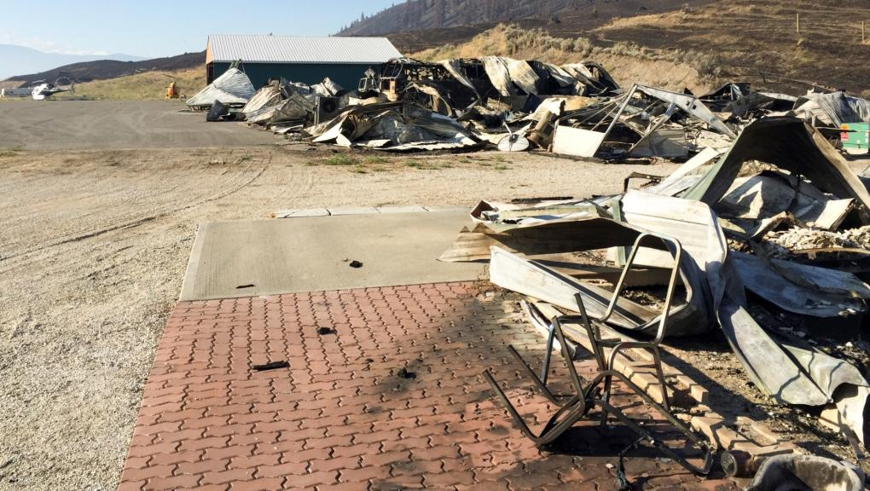
Wildfire prevention begins BEFORE
the fire occurs and in our own backyards.
FireSmart is a shared responsibility.
Notes:
Wildfire is a threat to our community and its neighbourhoods.
This threat cannot be solved by bringing in more firefighters or more equipment.
Solving the problem depends on what happens BEFORE the fire occurs and in our own BACKYARDS.

Slide 18
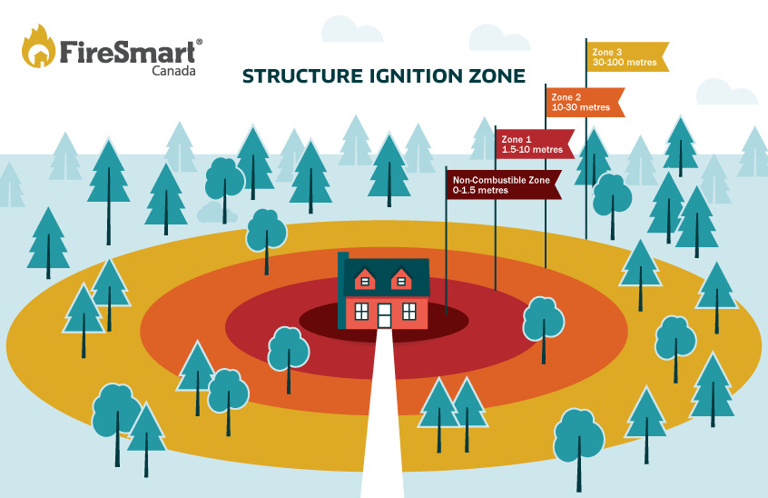
Wildfire structure survival statistics
4% survival: flammable roof, no treatment and no defensive action
20% survival: flammable roof
70% survival: non-flammable roof
90% survival: < 10 metres (Zone 1) or more of vegetation is treated
Notes:
4% survival in homes with flammable roof, no treatment and no defensive action
20% survival of homes with flammable roof
70% survival of homes with non-flammable roof
90% survival if 10 metres (Zone 1) or more of vegetation is treated

Slide 19
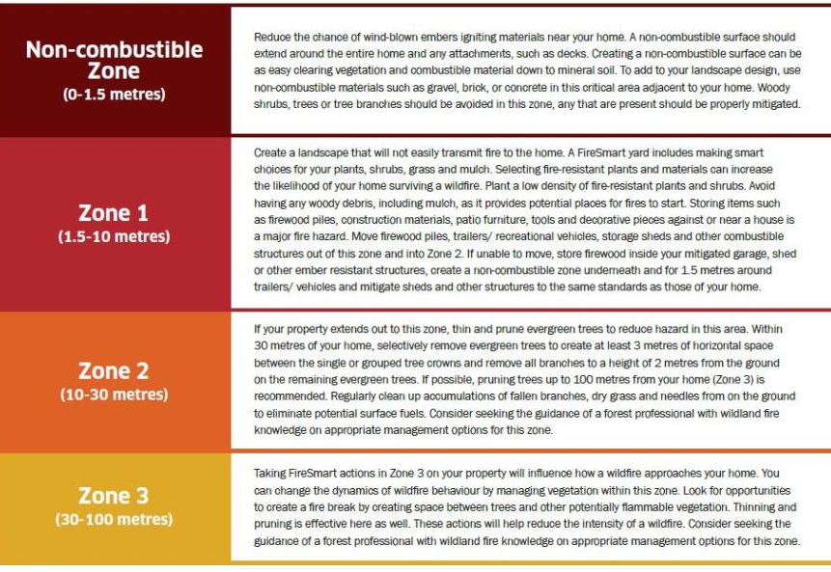
STRUCTURE IGNITION ZONE
Notes:
The main focus to reduce WUI wildfire disasters is within the home ignition zone, which is the home plus four priority zones extending outward from the structure, as shown in this image.
The goal is to protect homes from:
convective heat or direct flame
radiant heat from the flame front or from other homes
embers

Slide 20
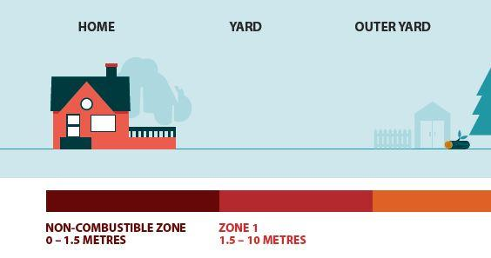
Non-Combustible Zone
The most critical zone (0 to 1.5 metres from the home)
Remove combustible material right down to the mineral soil
Use non-flammable materials such as gravel, brick or concrete in this critical area adjacent to your home
Avoid having woody shrubs, trees or tree branches in this zone

Slide 21
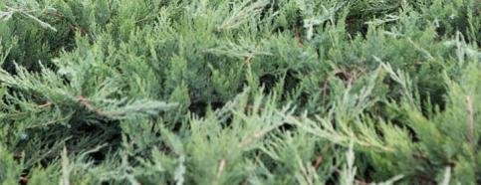
Non-Combustible Zone
CHARACTERISTICS OF FIRE- RESISTANT PLANTS
moist, supple leaves
accumulates minimal dead vegetation
water-like sap with little odour
low amount of sap or resin material
CHARACTERISTICS OF HIGHLY FLAMMABLE PLANTS
leaves or needles are aromatic
accumulates fine, dry dead material
contain resin or oils
Loose, papery or flaky bark
Examples of plants to AVOID planting: cedar, juniper, pine,
tall grass and spruce.

Slide 22
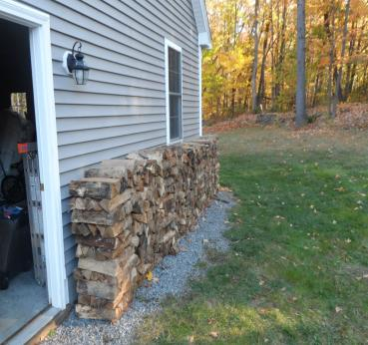
Zone 1
1.5 to 10 metres from the home
Create a FireSmart yard so that fire will not easily transmit to your home.
Plant low-density, fire-resistant plants and shrubs.
Avoid planting coniferous trees (cones and needles) in this zone, since they are highly flammable.
Keep lawns mowed.
Move firewood piles, construction materials, storage sheds and other combustible structures out of this zone and into Zone 2.
Notes:
Avoid planting coniferous trees (cones and needles) as they are highly flammable and should not be within 10 metres of your home.
Trees to plant are deciduous (leafy) trees that are resistant to wildfire. They include:
• poplar
• birch
• aspen
• cottonwood
• maple
• alder
• ash
• cherry

Slide 23
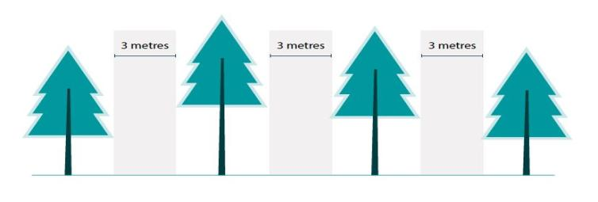
Zone 2
10 to 30 metres from home
Prune and trim evergreen trees to create at least 3 metres of horizontal space between single or grouped tree crowns.
On the remaining evergreen trees, remove all branches to a height of 2 metres above the ground.
Regularly clean up fallen branches, dry grass and needles from the ground to eliminate potential surface fuels.

Slide 24
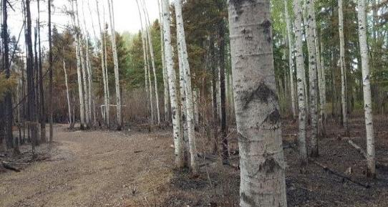
Zone 3
30 to 100 metres from home
Create an environment that will not support high-intensity crown fires.
A focus on fuel reduction and conversion (rather than removal) is the main priority in this zone.
Look for opportunities to create a fire break by creating space between trees and other flammable vegetation.

Slide 25
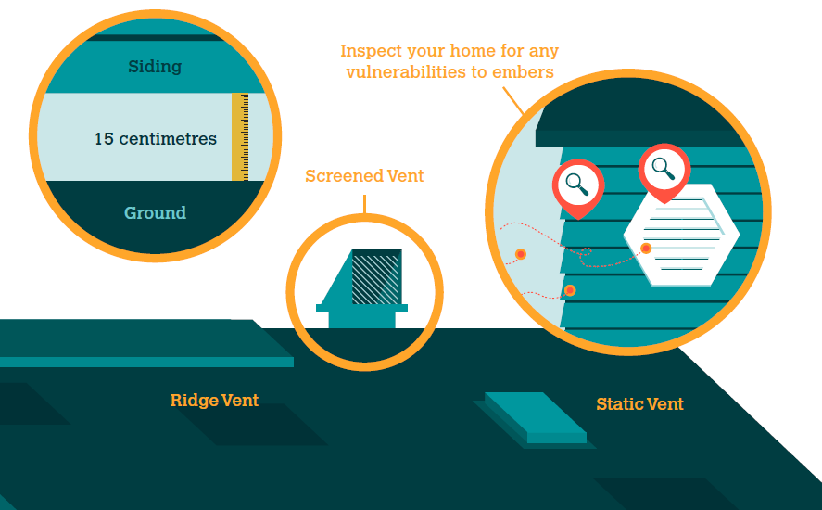
Homebuilding considerations
Always ensure roofs and gutters are clear of combustible material, vents and eaves are screened in or enclosed ,and siding is free of gaps where embers could accumulate.
Notes:
Unscreened vents can allow heat and embers to enter a building and ignite it.
With inadequate ground-to-siding clearance, accumulated embers can ignite combustible siding directly. At least 15 centimetres of ground-to-siding, non-combustible clearance is recommended.
Install non-combustible material for all vents. They should be 3-millimetre screening or ASTM (American rating system) fire rated vents. Metal products are recommended for vents and vent flashing.
To watch a video of a homeowner who built their new home using FireSmart – https://firesmartbc.ca/resource/home-owner-tour-dave/

Slide 26
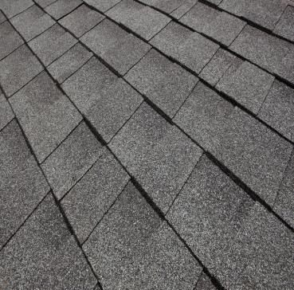
Recommended home roofing materials
Roofing material tested for flammability is assigned a classification:
CLASS A – high resistance to fire
CLASS B – moderate resistance to fire
CLASS C – low resistance to fire
The roof is the most VULNERABLE component of your home. Sparks and burning embers from a wildfire can travel long distances and quickly ignite flammable roofing material.
Notes:
The fire rating of a roof covering relies on the entire roof assembly (sheeting, drip edges and end caps) to offer the rated protection.
Class A fire-rated roof assembly offers the best protection. Examples of Class A roofing material include clay tile, concrete tile,
metal and asphalt shingles.
Class C roofing has the lowest resistance to fire. Untreated wood shakes are classified as Class C because they create a dangerous combination of combustible material and crevices for embers or sparks to enter.
Roof features such as skylights and solar panels could be entry or accumulation points for wind-blown embers. Keep these features clear of combustible debris and properly maintained.

Slide 27
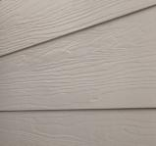

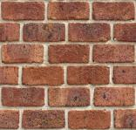
Recommended home siding materials
Fibre cement siding
Aside from the roof, the structural component most vulnerable to wildfire is siding material.
Vinyl siding can melt when exposed to high temperatures, allowing fire to reach the interior of the building.
Fibre cement board panels, stucco, brick and poured concrete offer superior fire resistance.
Stucco siding
Brick siding
Notes:
Siding is vulnerable when it ignites and when flames or embers get into the cavity behind the siding. With inadequate ground-to-siding clearance, accumulated embers can ignite combustible siding directly. At least 15 centimetres of ground-to-siding, non-combustible clearance is recommended.
Examine your siding for locations where embers could accumulate. Maintaining and removing combustible debris (such as lumber, stored vehicles, branches, grass and leaves) and firewood near the exterior walls will reduce a building’s vulnerability to ignition during a wildfire.

Slide 28
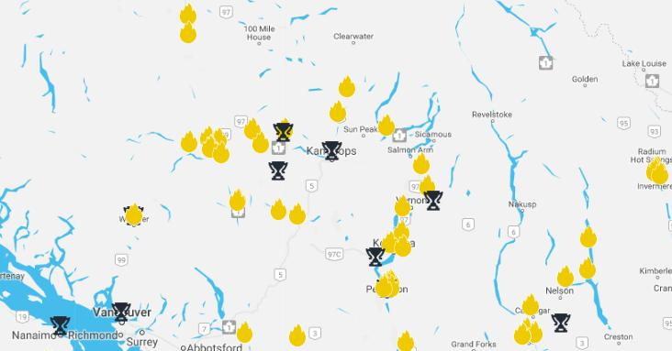
FireSmart Community Recognition Program
Notes:
Watch a video about a FCCRP Community who received FCCRP recognition
Anarchist Mountain Community Profile Video: https://firesmartbc.ca/resource/anarchist-mountain-community-profile/
The role and Impact of a FireSmart Coordinator Video: https://firesmartbc.ca/resource/the-role-and-impact-of-a-firesmart-coordinator/

Slide 29
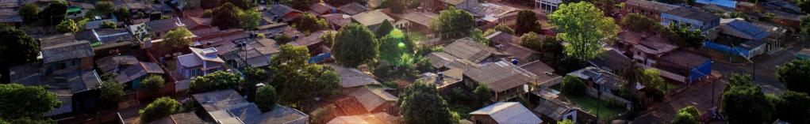
Community recognition program
Contact a Local FireSmart Representative (LFR).
Create community representation.
Local FireSmart Representative completes assessment and evaluation.
Create a FireSmart Community Plan.
Implement mitigation recommendations/solutions.
Apply for recognition.
Renew your recognition status and work to increase the number of FireSmart homes in your neighbourhood.
Notes:
Communities in B.C. that have been recognized by FireSmart Canada as being FireSmart have shown that they are taking the steps necessary to build truly wildfire-resilient communities. These recognized communities have FireSmart Community Plans, FireSmart Boards, and are working to reduce the wildfire risk to their community, neighbourhoods, and individual homes.
The steps are:
Contact a Local FireSmart Representative to request a site visit (there is a link to LFR contact information on www.FireSmartBC.ca).
Create community representation: Community Champion and/or Local FireSmart Representative recruits others from your community to create a FireSmart Board with can include other homeowners and fire professionals.
Local FireSmart Representative completes assessment and evaluation: A Wildfire Hazard Assessment Form is completed, The LFR provides an evaluation of the community’s wildfire readiness and schedules a meeting with your local FireSmart Board to present the assessment for review and acceptance by the Board.
Create a FireSmart Community Plan: Your local FireSmart Board develops a FireSmart Community Plan (a set of solutions to its WUI fire issues, based on the Local FireSmart Representative’s report). All members of the FireSmart Board must concur with the final plan which is presented to and approved by the provincial/territorial FireSmart Liaison. The Local FireSmart Representative may work with your community to seek project implementation funds if needed.
Implement solutions: Solutions from your FireSmart Community Plan are implemented, following a schedule designed by your FireSmart Board, which will be responsible for maintaining the program in future. Here you would complete your Volunteer and Resource Tracker to record your event and community involvement.
Apply for recognition – FireSmart Community recognition status is achieved after your community submits its application form along with a completed FireSmart Community Plan and FireSmart Event documentation to your Local FireSmart Representative.
Renewing your recognition status – Annual renewal of your recognition is completed by submitting documentation of your community’s continued participation to the provincial/territorial FireSmart Liaison.

Slide 30

FireSmart BC

Slide 31



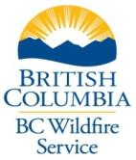
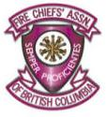


The BC FireSmart Committee
Membership:
Ministry of Forests, Lands, Natural Resource Operations and Rural Development, as represented by the BC Wildfire Service
Office of the Fire Commissioner
Union of B.C. Municipalities
Fire Chiefs’ Association of B.C.
Emergency Management BC
Forest Enhancement Society of B.C.
First Nations’ Emergency Services Society of B.C.
FireSmart Canada
Notes:
The BC FireSmart Committee was established in May 2017 to ensure greater direction and integration of the seven FireSmart disciplines throughout the province. The committee consists of members from:
Ministry of Forests, Lands, Natural Resource Operations and Rural Development, as represented by the BC Wildfire Service
Office of the Fire Commissioner
Union of B.C. Municipalities
Fire Chiefs’ Association of B.C.
Emergency Management BC
Forest Enhancement Society of B.C.
First Nations’ Emergency Services Society of B.C.
FireSmart Canada also sits on the committee in an advisory capacity.
Many communities face wildfire threats that span multiple jurisdictions, and many communities have indicated there are challenges relating to capacity and expertise.
We believe there is great value in working together on a solution for a shared problem. We’re hoping the BC FireSmart Committee can help all of you take greater and more co-ordinated strides to make our communities more resilient to wildfire.

Slide 32
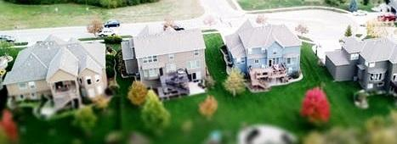
Committee purpose
The B.C. FireSmart Committee works to collaboratively maintain and improve the delivery of the BC FireSmart program by ensuring alignment with the seven FireSmart disciplines, to better support wildfire preparedness, prevention and mitigation in B.C.
In meeting their purpose, they commit to aligning with FireSmart Canada, developing an annual work plan and budget, and providing stakeholders and interested parties with one governing agency for FireSmart in B.C.

Slide 33
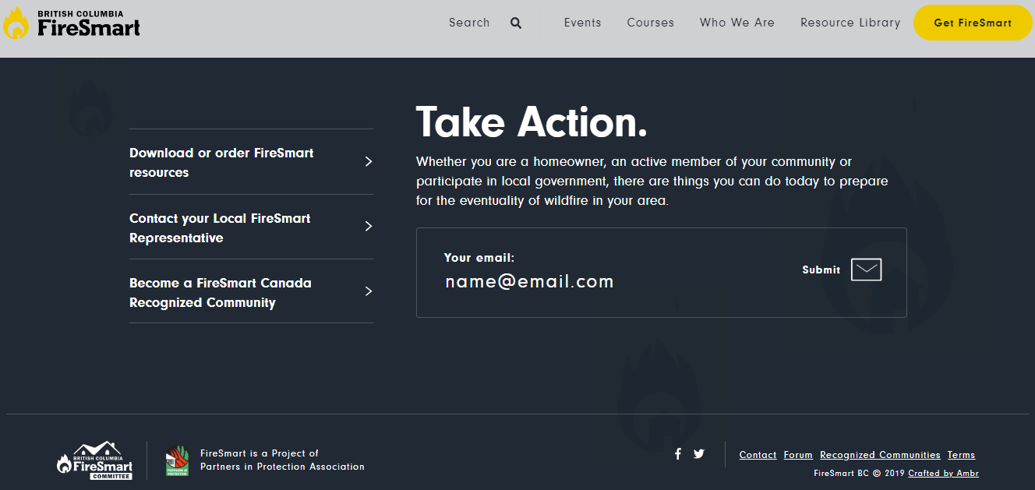
www.FireSmartBC.ca
Notes:
Your “one-stop shop” for everything FireSmart in B.C. is www.FireSmartBC.ca
Here you can find information about upcoming events and courses, the Resource Library, contact information for Local FireSmart Representatives, how to become a FireSmart Canada Recognized Community, and a map indicating FireSmart recognized communities in B.C.

Slide 34
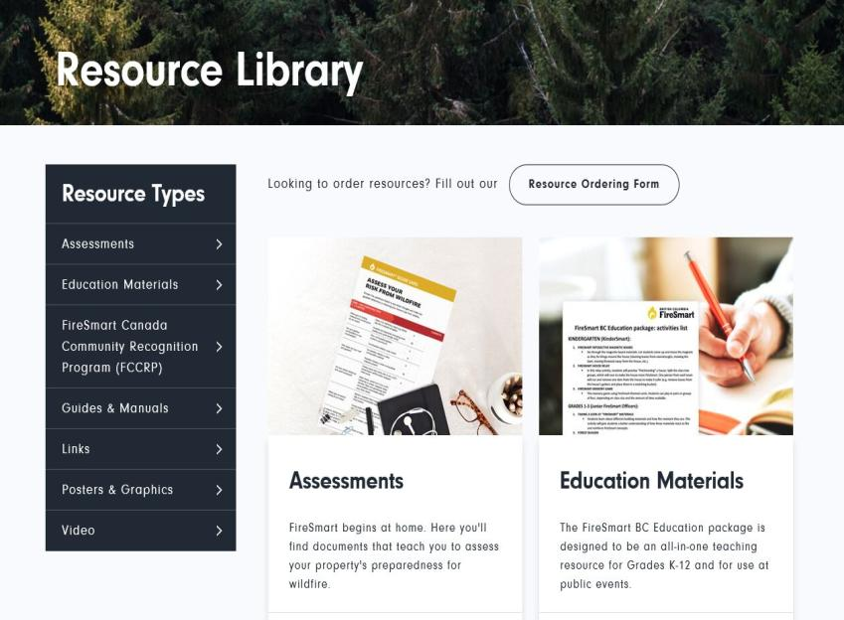
FireSmart resources
Notes:
https://firesmartbc.ca/resources/
The newly updated resource section of the website is your one stop shop for all things related to FireSmart.
7 different sub categories that expands and provides downloadable forms, watch videos, learn hot to properly apply for the FCCRP program
Click on the Resource Ordering Form - https://firesmartbc.ca/resource-ordering-form/
To order 6 different types of resources free of charge (FireSmart Begins at Home Manual, Landscaping Manual, FireSmart Bookmark) Click Resource Ordering Form
Videos: Validation/ Testimonials
Pat Crook FireSmart Testimonial - https://firesmartbc.ca/resource/pat-crook-firesmart-testimonial/
Bruce Perrin (Fire Chief) Testimonial - https://firesmartbc.ca/resource/bruce-perrin-beaverly-fire-chief/

Slide 35

Contact information
Notes:
For more information or to get in touch with the BC FireSmart Committee, email info@firesmartbc.ca
Add your own contact information here

Slide 36
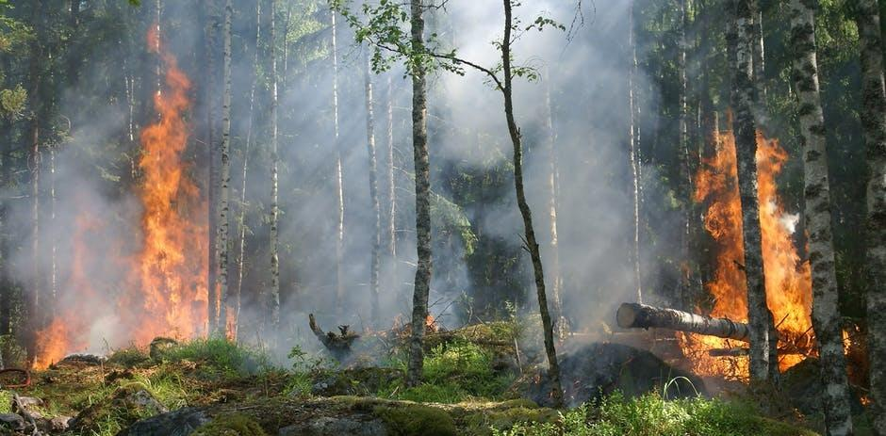
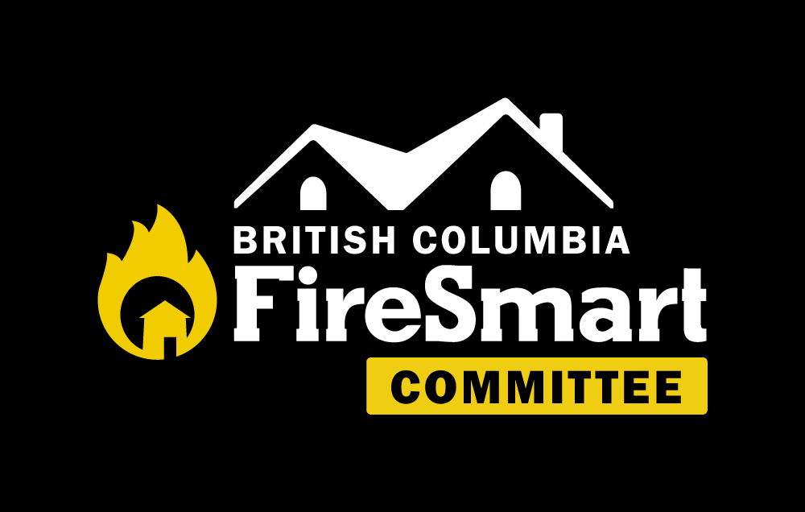
Questions
FireSmart is a registered trademark of Partners in Protection

